Slide 1
USING TECH TO CONDUCT BUSINESS DURING COVID-19
Presented by: Heather Holmes

Slide 2
41 - 1 bdrm
14 - 2 bdrm
(total 55)
33 - underground parking
50 - surface stalls
(total 83 stalls)
Notes:
PGGM1, LLC $8 million 73,000 square foot, market rate apartment complex. Would’ve halted the project.

Slide 3
USING TECH TO CONDUCT BUSINESS DURING COVID-19
TIMELINE
March 4, 2020 - Planning & Zoning approves height and parking variances
March 13, 2020 - Peacetime emergency declared by the Governor in Executive Order 20-01
Social distancing guidelines and requirements prevent public gathering of 10+ affecting ability to hold public hearings/special meetings at City Hall
March 25th, 2020 - Special Meeting on Flats 55 Apartment project, Stewartville, MN
March 30th, 2020 - MN House of Representatives Emergency House Operations
April 14th, 2020 - Final Special Meeting on Flat 55 Apartment project, Stewartville, MN

Slide 4
USING TECH TO CONDUCT BUSINESS DURING COVID-19
OPTIONS IN THE “NEW NORMAL”
Cancel or postpone meetings
Conduct meetings virtually while adhering to The Open Public Meetings Act
The Open Public Meetings Act does not require that citizens be allowed to participate and speak at council meetings
The Open Public Meetings Act does require that citizens be allowed to participate and speak at a public hearing, which is a formal proceeding conducted for the purpose of discussing a specific topic, in this case, a multifamily project, Flats 55
What to do? Started with research and asked an expert (or two)

Slide 5
USING TECH TO CONDUCT BUSINESS DURING COVID-19
MINNESOTA STATE STATUTE - CONDITIONS
A meeting may be conducted by telephone or other electronic means so long as the following conditions are met:
The presiding officer, chief legal counsel, or chief administrative officer for the affected governing body determines an in-person meeting is not practical or prudent because of a health pandemic or an emergency declared.
All members of the body participating in the meeting, wherever their physical location, can hear one another and can hear all discussion and testimony.
Members of the public present at the regular meeting location of the body can hear all discussion and testimony and all votes of the members of the body, unless attendance at the regular meeting location is not feasible due to the health pandemic or emergency declaration.
At least one member of the body, chief legal counsel, or chief administrative officer is physically present at the regular meeting location, unless unfeasible due to the health pandemic or emergency declaration. All votes are conducted by roll call, so each member's vote on each issue can be identified and recorded.

Slide 6
USING TECH TO CONDUCT BUSINESS DURING COVID-19
SPECIAL MEETING/PUBLIC PARTICIPATION - FACEBOOK LIVE
Conferred with City Attorney and independent attorney on utilizing Facebook Live option as it related to the current MN State Statute regarding MEETINGS BY TELEPHONE OR OTHER ELECTRONIC MEANS; CONDITIONS
Specifically addressing Condition (3) members of the public present at the regular meeting location of the body can hear all discussion and testimony and all votes of the members of the body, unless attendance at the regular meeting location is not feasible due to the health pandemic or emergency declaration

Slide 7
USING TECH TO CONDUCT BUSINESS DURING COVID-19
SPECIAL MEETING/PUBLIC PARTICIPATION - FACEBOOK LIVE
Live streamed March 25th and April 14th special meetings on the @CityofStewartvilleMN Facebook page
Allowed public to participate off site with comments in real time through Facebook live stream
For those that wanted to call in, City Hall phone number was provided
Person monitoring the Facebook live stream and/or phone line verbally announced citizen by name and read the questions to the council
Person followed up in comments section with citizen to ensure they heard answer to their question

Slide 8
USING TECH TO CONDUCT BUSINESS DURING COVID-19
SPECIAL MEETING/PUBLIC PARTICIPATION - FACEBOOK LIVE
Ipad, mount, tripod, microphone
Wifi and/or hotspot backup
Identify person to man the equipment and monitor public comments/reactions
Perhaps enlist 2 people if necessary
Test, test, test. Dry run record, listen to audio, ensure everyone can be heard clearly
TEST EXAMPLE

Slide 9
USING TECH TO CONDUCT BUSINESS DURING COVID-19
POPULAR DIGITAL PLATFORMS FOR MEETINGS
Zoom
Google Hangouts
6 Differences Between Zoom & Google Hangouts You Should Know
Go To Meeting

Slide 10
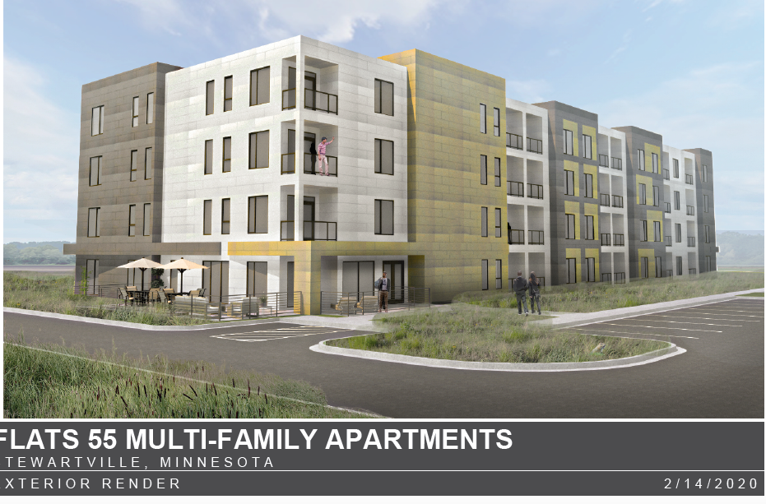
USING TECH TO CONDUCT BUSINESS DURING COVID-19
OUTCOME
Flats 55 Project began last Monday with Groundbreaking event on Wednesday
Project moving forward with original proposed completion Spring of 2021
Bill Schimmel!!😁

Slide 11
USING TECH TO CONDUCT BUSINESS DURING COVID-19
QUESTIONS?

