Slide 1
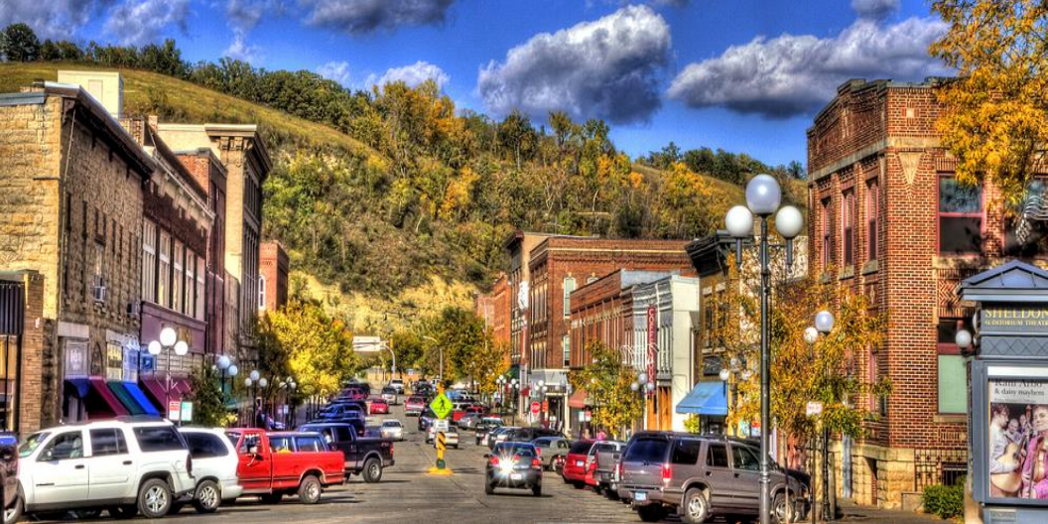
CLIENT
LOGO HERE
SOUTHEAST MINNESOTA REGIONAL ECONOMIC STUDY
FINDINGS & POLICY RECOMMENDATIONS
2018

Slide 2
PROJECT OVERVIEW | A State grant appropriation through DEED provided funding
for SEMLM and CEDA to understand economic impacts facing Southeast Minnesota (the
Region). Findings from this study will enable communities to prepare for both future
economic challenges and opportunities.
Working in
partnership with
60+ municipalities
PROJECT DIRECTION & STAKEHOLDER ENGAGEMENT
HR&A Advisors, Inc.
SE Minnesota Regional Economic Study | 3

Slide 3
PROJECT OVERVIEW | This study seeks to evaluate the regional economic and
demographic impacts of proposed plans and economic development initiatives, and to
provide regional stakeholders with training on an economic tool that can be used to
assess the impacts of future projects.
8
POTENTIAL IMPACTS:
•
•
•
Population Changes
Demographic Changes
Infrastructure & Service
Needs Changes
COUNTIES
Goodhue
78
Wabasha
MUNICIPALITIES,
65 OF WHICH
ARE SEMLM MEMBERS
Dodge
Olmsted
Winona
368k
Mower
Fillmore
Houston
REGIONAL
POPULATION
HR&A Advisors, Inc.
SE Minnesota Regional Economic Study | 4

Slide 4
PROJECT OVERVIEW | Since project commencement, HR&A reviewed materials
received from Southeastern municipalities, counties, and regional groups about
challenges and initiatives underway in the Region, supplementing this data review with
targeted conversations.
ANALYSIS OF
EXISTING
DEMOGRAPHIC &
EMPLOYMENT
DATA TRENDS
REVIEWED &
SUMMARIZED
INFORMATION FROM
26 MUNICIPALITIES &
8 COUNTIES
INTERVIEWS WITH
MORE THAN 25
MUNICIPALITIES & THE
8 COUNTIES
EXISTING
CONDITIONS
HR&A Advisors, Inc.
SE Minnesota Regional Economic Study | 5

Slide 5
PROJECT OVERVIEW | This Study uses REMI software, a dynamic industry-standard
econometric modelling software, to simulate 25-year socioeconomic growth scenarios for
the Region.
The model is long-term, capturing county-wide economic and
demographic projections over many decades;
Flexible, allowing users to modify inputs based on changing
economic conditions;
It’s the industry-standard, frequently used by federal, state, and
local governments, (including DEED) economic and transportation
authorities, and private groups; and,
County-wide projections can be translated to the municipal-level,
allowing impacts to be understood with a
granularity.
high degree of
HR&A Advisors, Inc.
SE Minnesota Regional Economic Study | 6

Slide 6
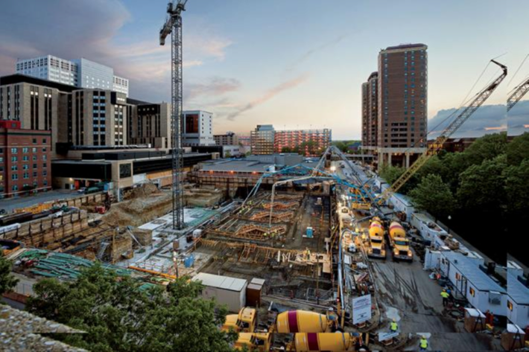
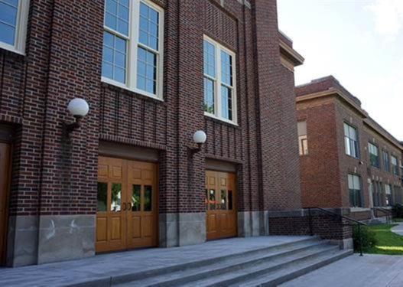
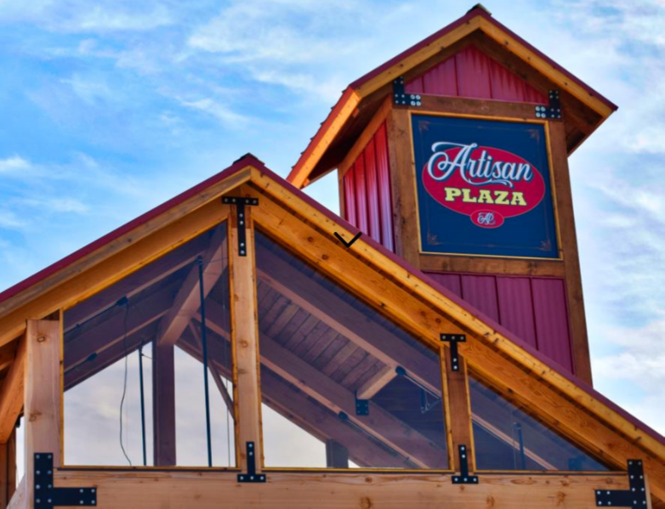
REGIONAL TRENDS | To support the Region’s continued growth, communities
throughout the Region work to implement a range of economic development strategies
and programs.
DESTINATION MEDICAL
CENTER
CHATFIELD CENTER
FOR THE ARTS
CANNON FALLS ARTISAN
PLAZA
RED WING HISTORIC
DOWNTOWN LIGHTS
AUSTIN HOME TAX
ABATEMENT
HR&A Advisors, Inc.
SE Minnesota Regional Economic Study | 8

Slide 7
REGIONAL TRENDS | The Region’s population grew by more than 67,000 since
1970, while the state added more than 1.6 million in the same period.
Southeast Region & Minnesota Population, 1970-2015
400,000
6,000,000
350,000
+0.79%
Annual Growth
5,000,000
+0.63% Annual
Growth
300,000
4,000,000
250,000
3,000,000
200,000
2,000,000
1970
1980
1990
2000
2010
2015
Southeast Minnesota
Minnesota
Source: Census, ACS
HR&A Advisors, Inc.
SE Minnesota Regional Economic Study | 9

Slide 8
REGIONAL TRENDS | The Region’s population is increasingly educated, with the
share of residents receiving some college education increasing by 4% since 2009.
Educational Attainment, 2016
34%
33%
28%
26%
23%
20%
7% 7%
7%
8%
3% 2%
2% 1%
Source: ACS
Southeast Region
State of Minnesota
HR&A Advisors, Inc.
SE Minnesota Regional Economic Study | 10

Slide 9
REGIONAL TRENDS | Lower birth rates and a growing senior population has led to
population stagnation in the Region.
Shares of Youth & Seniors in the Region, 1980-2015
40%
400,000
37%
344,000
35%
350,000
30%
270,000 32%
31%
300,000
29%
29%
25%
250,000
20%
200,000
15%
150,000
10%
100,000
5%
6.5%
7.5%
7.7%
7.9%
8.0%
50,000
0%
-
1980
1990
2000
2010
2015
Aged 17 & Under
Aged 65+
Population
Source: Census, ACS
HR&A Advisors, Inc.
SE Minnesota Regional Economic Study | 11

Slide 10
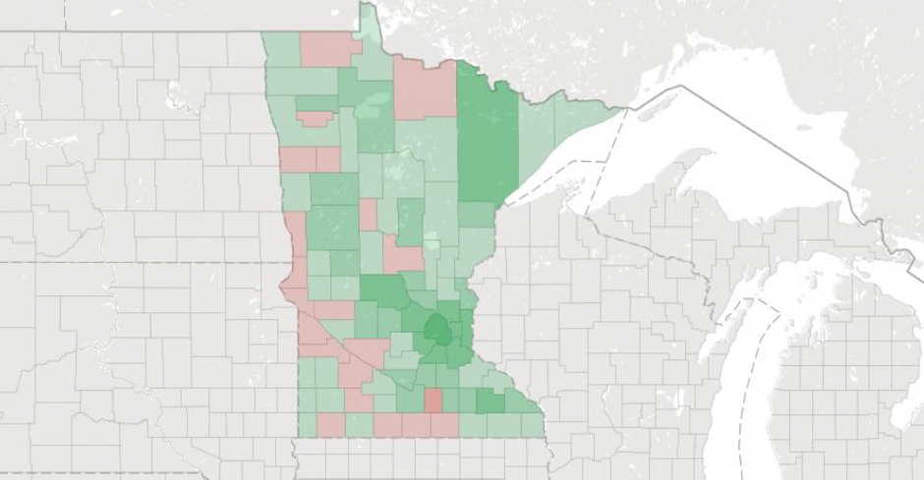
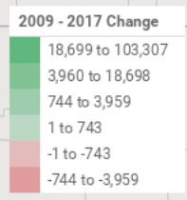
REGIONAL TRENDS | Employment in the Region has steadily increased over the last
several decades, adding more than 80,000 jobs since 1970. Since 2009, the Region’s
job growth has exceeded other more rural parts of the state.
Statewide Change in Jobs, 2009-2016
Source: Emsi
HR&A Advisors, Inc.
SE Minnesota Regional Economic Study | 12

Slide 11
REGIONAL TRENDS | Health care, manufacturing, and government are the Region’s
largest industry employers. Combined, these industries make up more than 50% of the
Region’s jobs.
Major Industries, 2009-2017
Construction
+320 jobs
Tourism
+1,920 jobs
Retail Trade
+265 jobs
Manufacturing
+605 jobs
Government
+610 jobs
Health Care and Social Assistance
+5,680
jobs
-
15,000
30,000
45,000
60,000
2017
2009
Note, Tourism includes Arts, Entertainment, and Recreation and Accommodation and Food Services
Source: Emsi
HR&A Advisors, Inc.
SE Minnesota Regional Economic Study | 13

Slide 12
REGIONAL TRENDS | The Region’s unemployment is lower than both the state and the
nation, and labor force participation is aligned with the state’s, which is higher than the
nation.
Unemployment, 2015
Labor Force Participation, 2015
5.6%
71%
71%
5.3%
4.8%
62%
2015
Southeast Region
Minnesota
United States
Source: ACS, BLS, REMI
HR&A Advisors, Inc.
SE Minnesota Regional Economic Study | 14

Slide 13
REGIONAL TRENDS | Southeast Minnesota faces labor shortages, as seen by the
Region’s 10,000 unfilled jobs, resulting from employers’ inability to reach skilled workers.
Unfilled Jobs by Industry
1,552
1,404
1,142 1,118
1,113
912
805
774
727
501
394
364
Source: MN DEED; note, Other includes: Arts, Design, Entertainment, Sports & Media, Management, Computers & Mathematical, Construction & Extraction, Business &
Financial Operations, Legal, Architecture & Engineering, Healthcare Practitioners & Technical, Life, Physical, & Social Science, Food Preparation, Education & Library
HR&A Advisors, Inc.
SE Minnesota Regional Economic Study | 15

Slide 14
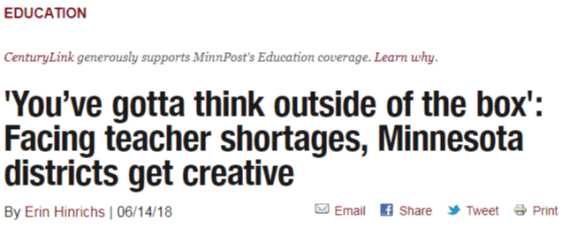
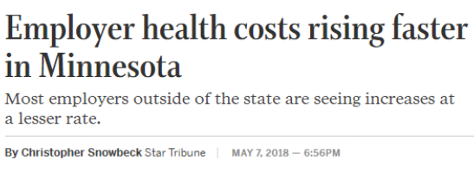
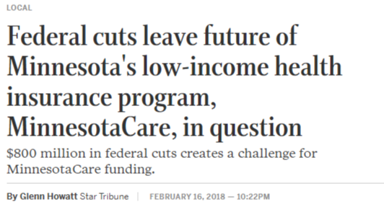
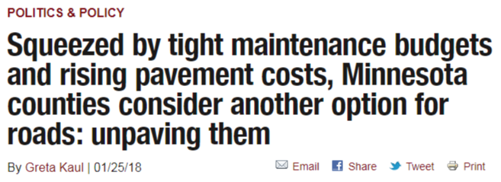
REGIONAL TRENDS | Lower state and federal funding combined with rising fixed
costs places additional strain on amenities and public services.
HR&A Advisors, Inc.
SE Minnesota Regional Economic Study | 16

Slide 15
REGIONAL TRENDS | This Study used the State Demographic Center’s conservative
population projections, and extrapolated employment projections, to calibrate a Baseline
Forecast that incorporates projected growth associated with existing and planned
initiatives.
SDC FORECAST
BASELINE
FORECAST
DMC + ROCHESTER-
OLMSTED PLANNING DEPT.
GOODHUE HOUSING
FORECAST
Wabasha
Winona
Fillmore
Houston
Goodhue
Dodge
Mower
Olmsted
HR&A Advisors, Inc.
SE Minnesota Regional Economic Study | 17

Slide 16
REGIONAL TRENDS | The Baseline Forecast projects that the Region will see growth
of 50,200 residents between 2015 and 2040, up to 419,200 total residents.
Regional Population Projection, 2010-2040
425,000
419,246
400,000
375,000
384,671
350,000
325,000
SDC Forecast
Baseline Forecast
Source: Census, ACS
HR&A Advisors, Inc.
SE Minnesota Regional Economic Study | 18

Slide 17
REGIONAL TRENDS | The Baseline Forecast projects that the Region will see growth
of 44,400 employees between 2015 and 2040, up to 286,300 total employees,
including 7,660 spin-off jobs throughout the Region as a result of the DMC.
Regional Employment Projection, 2010-2040
300,000
275,000
286,342
250,000
258,396
225,000
200,000
SDC Forecast
Baseline Forecast
Source: Census, ACS
HR&A Advisors, Inc.
SE Minnesota Regional Economic Study | 19

Slide 18
REGIONAL TRENDS | While communities throughout the Region are faced with
distinct challenges and opportunities, three primary policy areas can be addressed at
the regional-scale for maximum impact.
HOUSING
TRANSPORTATION
LABOR SUPPLY
HR&A Advisors, Inc.
SE Minnesota Regional Economic Study | 20

Slide 19
REGIONAL TRENDS | Communities throughout the Region have identified the need
for increased and diversified housing, though local market conditions and regulatory
barriers impede supply.
•
Between 2009 and 2016, the Region needed
5,500 housing units to meet the population’s needs,
exceeding new construction by 1,900 units
•
The DMC Development Plan estimates that
between 2,300 and 3,100 new housing units will be
needed in the Development District
HOUSING
•
Plainview identified the need for more than 350
units by 2025, and Red Wing reports demand for
460 senior housing units by 2020 based on
current trends
•
Responding to limited development, Austin
implemented a 5-year property tax abatement for
new home construction, and Lanesboro is looking to
allow infill development to address housing needs
HR&A Advisors, Inc.
SE Minnesota Regional Economic Study | 21

Slide 20
REGIONAL TRENDS | Geographically large, the Region faces challenges providing
sufficient transportation options to connect the work force to employment opportunities.
•
Employers in the Region identified challenges
retaining employees without an alternative
transportation system, due to the cost and time
burden of commutes
•
With the growth of employment centers
throughout the Region, more coordinated and robust
transportation options are needed
TRANSPORTATION
•
A regional transportation system can help connect
employers to workers, addressing part of the
Region’s 10,000 unfilled jobs
HR&A Advisors, Inc.
SE Minnesota Regional Economic Study | 22

Slide 21
REGIONAL TRENDS | Without affordable and accessible childcare, employment
options for the Region’s workforce are limited. This burden disproportionately impacts
manufacturing and agricultural industries because of the wages associated with these
industries.
•
Nationally, more than 60% of households with two
parents had both parents engaged in the
workforce, up from 40% in 1968
•
Among people aged 25-64 within the Region, the
labor participation rate decreased from 81% in
2001 to 75% in 2016
LABOR SUPPLY
•
A key barrier identified to labor participation is a
lack of family-friendly work policies, including
affordable childcare options and more flexible
shift-times
•
Communities, including Byron, Stewartville, Spring
Valley, and Lake City, are encouraging childcare
development
HR&A Advisors, Inc.
SE Minnesota Regional Economic Study | 23

Slide 22
INITIATIVES | In addition to the baseline population and employment forecasts, this
Study analyzed the impacts of key regional trends and potential regional initiatives,
identified through stakeholder consultation, that will impact the Region’s future growth.
Growing Need for Housing
Labor Supply
Demand for Regional Transportation
BASELINE POPULATION &
EMPLOYMENT FORECASTS
+
International Migration
Growth of Tourism & Recreation
Healthcare Insurance Costs
Agriculture & Manufacturing
HR&A Advisors, Inc.
SE Minnesota Regional Economic Study | 25

Slide 23
HOUSING | Municipalities and counties expressed the need for affordable housing
and diversified housing typologies as two significant issues facing their communities.
These challenges will be compounded by the growth of the DMC.
EXISTING CONDITIONS
FUTURE GROWTH
•
13.7k new residents between
2009 and 2016, and only
3.6k new housing units in the
same period, creating large
unmet demand.
•
With the implementation of the DMC,
anticipated to create between 37k and
47k direct and indirect jobs in the region,
the current pace of housing supply will
need to increase 2X to meet the growing
workforce’s housing needs.
•
A lack of diverse housing
options, especially for seniors
and young professionals,
exacerbates the already
restricted housing market.
•
Without greater diversification of housing
options, housing costs will rise and the
labor pool may become restricted, as
employees are unable to find affordable
housing proximate to workplaces.
Notes: Average Household Size is 2.5; DMC projects the creation of 26,800-32,200 direct and 10,000-15,000 indirect jobs.
Source: ACS 5-Year, 2012-2016; DMC Integrate Studies; Emsi Economic Model; DMC Development Plan
HR&A Advisors, Inc.
SE Minnesota Regional Economic Study | 26

Slide 24
HOUSING | Historically, the Region has seen a 0.33% annual increase in housing
supply, compared to the Region’s population growth of 0.36%. This gap will increase as
the Region’s population grows, with significant demographic and economic impacts.
Housing Gap, 2017-2040
TOTAL IMPACTS BY 2040,
WITHOUT REQUIRED
HOUSING PRODUCTION:
14,100
(25,200)
Residents
($4.14B)
4,700
Economic Output
($1.14B)
Housing Gap, 2017
Housing Gap, 2040
Earnings
Source: ACS, REMI
HR&A Advisors, Inc.
SE Minnesota Regional Economic Study | 27

Slide 25
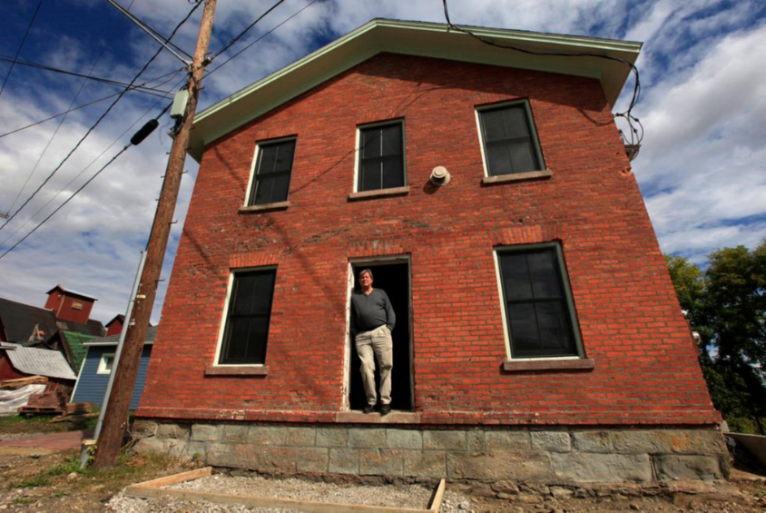
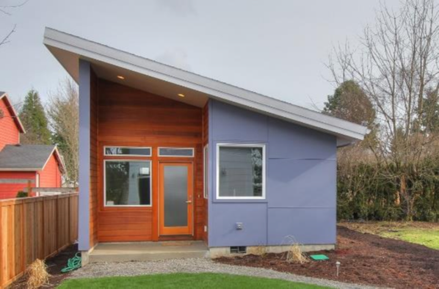
HOUSING | To address the growing demand for diversified and affordable housing
within the Southeast Region, communities can explore many options to help fill the
housing gap, including policy changes at different regulatory levels.
MOUNT MORRIS, NY
ACCESSORY DWELLING UNITS
•
A downtown development program gave
private developers an inventory of all
buildings downtown with detailed
property information that helped catalyze
private investment.
•
Seattle, WA, Portland, OR, and Santa
Cruz, CA have had ADU policies in place
for a number of years.
• The share of ADUs on all single-family lots
among the selected national precedents
ranges from 0.8% to 1.9%.
HR&A Advisors, Inc.
SE Minnesota Regional Economic Study | 28

Slide 26
LABOR SUPPLY | Across the region, communities highlight labor shortages as a
significant constraint to future economic growth and business attraction and expansion.
EXISTING CONDITIONS
FUTURE GROWTH
•
Limited availability and
affordability of daycare and
childcare providers.
•
Increasingly, one parent in two-parent
households will leave the workforce to
care for children, limiting economic
development potential.
•
Low wages offered by
employers. Workers outside of
Olmsted County make 20%
less than workers in Olmsted
County, averaging $58,000
compared to $69,000.
•
Shift-based industries, and specifically
manufacturing and agricultural
industries, are disproportionately
affected by a lack of childcare options.
•
Smaller job centers throughout the
region experience labor shortages,
•
High competition for skilled
workers, in part due to low
wages.
while Rochester struggles to provide
services for a swelling workforce.
HR&A Advisors, Inc.
SE Minnesota Regional Economic Study | 29

Slide 27
LABOR SUPPLY | By providing more affordable and accessible child care throughout
the Region, employment options for the Region’s workforce will increase, with particular
benefit to women in the Region.
Women’s Labor Force Participation, 2015
TOTAL IMPACTS BY 2040,
WITH LOWER CHILDCARE
COSTS:
70%
67%
66%
+5,900
65%
Jobs
60%
+$1.14B
56%
Economic Output
55%
+$282M
50%
Southeast
Minnesota
Minnesota
United States
Earnings
Source: REMI, BLS
HR&A Advisors, Inc.
SE Minnesota Regional Economic Study | 30

Slide 28
TRANSPORTATION | As Rochester continues to grow as a regional employment
center, and with the growth of smaller job centers throughout the region, commute times
and car-dependency will grow, increasing demand for a robust regional transportation
system.
32%
35%
1,850
Jobs in Rochester
are filled by workers
commuting from
outside the city
Households own
one or no cars
Ridership estimates
along proposed
priority routes in
the Region
Source: MnDOT, Southeast Minnesota Travel Study, 2016; ACS; Nelson\Nygaard Travel Study
HR&A Advisors, Inc.
SE Minnesota Regional Economic Study | 31

Slide 29
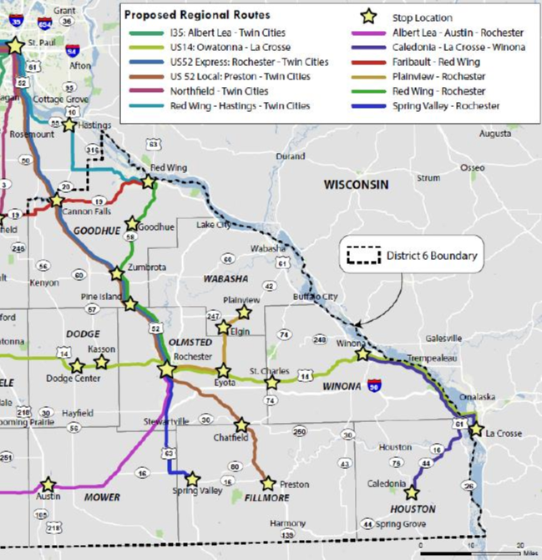
TRANSPORTATION | Regional transportation and quality connectivity will allow the
Region to address both housing and labor supply challenges, connecting workers to jobs
and diverse housing opportunities.
Means of Transportation to Work, 2016
TOTAL IMPACTS BY 2040,
WITH IMPROVED LABOR
ACCESS:
Worked
At Home,
5%
Other
Means,
2%
+1,100
Walked,
4%
Residents
Public
Transportation, 3%
+$460M
Car, Truck,
or Van,
87%
Economic Output
+$43M
Earnings
Source: Nelson\Nygaard
HR&A Advisors, Inc.
SE Minnesota Regional Economic Study | 32

Slide 30
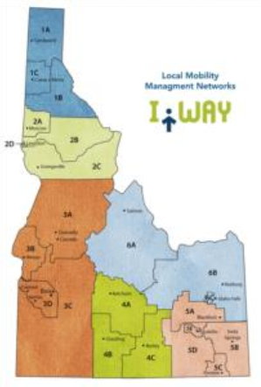
TRANSPORTATION | Half of all workers in Minnesota commute to a different county
for work, signaling need for a regional transportation system.
COMMUNITY TRANSPORTATION ASSOCIATION OF IDAHO
•
CTAI helps distribute federal and state funds to local
transit agencies
•
The CTAI employs a full-time mobility manager in each of
the state’s six transportation districts
•
These managers facilitate the coordinated planning
process and bring together key stakeholders
HR&A Advisors, Inc.
SE Minnesota Regional Economic Study | 33

Slide 31
IMMIGRATION | The State of Minnesota has a long history of becoming the new
home for international migrants and refugees seeking better opportunities or fleeing
persecution.
2%
13%
State of Minnesota’s share
of the nation’s population
State of Minnesota’s share
of the nation’s refugees
Source: Census, via Twin Cities Pioneer Press
HR&A Advisors, Inc.
SE Minnesota Regional Economic Study | 34

Slide 32
IMMIGRATION | The Region’s immigrant population grew from a 4.2% share of the
population in 2000 to 6.4% in 2016. Providing services to support this population will
grow the Region’s labor supply and contribute to long-term economic growth.
Foreign-Born Population by Continent of Birth
TOTAL IMPACTS BY 2040,
WITH HIGHER CAPTURE OF
IMMIGRANTS:
+2,000
Europe,
2,532
Jobs
Americas,
7,440
+$380M
Economic Output
Asia,
8,830
+$25M
Africa,
4,330
Earnings
Source: ACS
HR&A Advisors, Inc.
SE Minnesota Regional Economic Study | 35

Slide 33
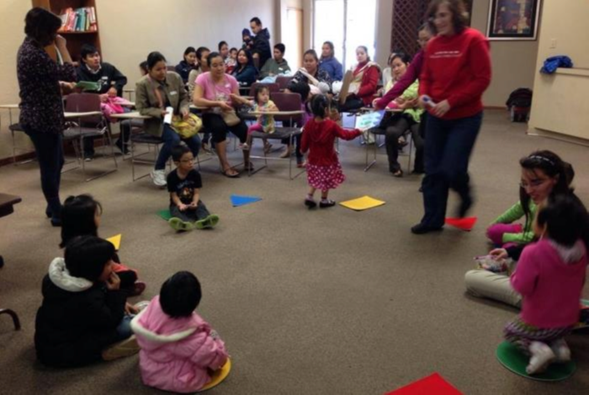
IMMIGRATION | Increasing the rate of international immigration increases long-term
economic growth by providing an endogenous source of new labor supply and
innovation.
WELCOME CENTERS
•
There is an
opportunity to
formalize the
Region’s
immigrant
welcome centers
and services
Welcome Center, Austin
Welcoming America, St. Charles
•
This effort can be
led by non-profits
and institutions
with support from
regional
organizations
Karen Parent Education, Austin
Project FINE, Winona
HR&A Advisors, Inc.
SE Minnesota Regional Economic Study | 36

Slide 34
TOURISM | Communities throughout the Region recognize the importance of outdoor
recreation as a tool for economic development and industry diversification, and a
regional tourism strategy will create additional economic opportunities.
41%
16,000
Growth in annual sales,
leisure and hospitality
businesses in the State of
Minnesota, 2005-2015
Leisure and hospitality
jobs, Southeast
Minnesota, 2016
Source: Explore Minnesota
HR&A Advisors, Inc.
SE Minnesota Regional Economic Study | 37

Slide 35
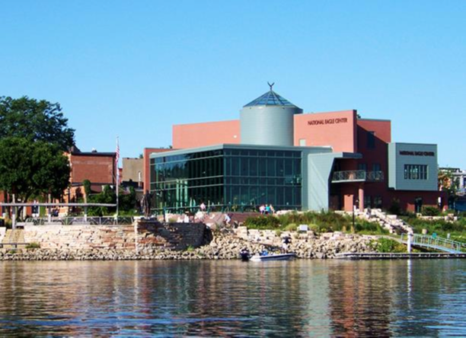
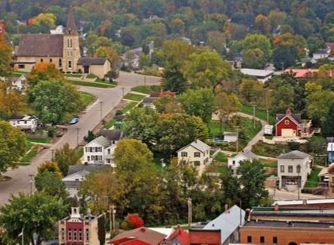
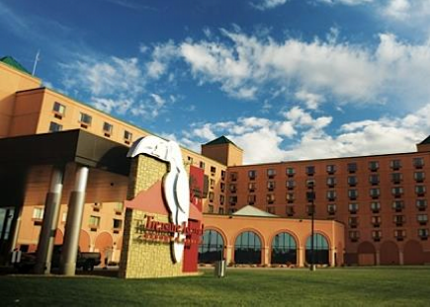
TOURISM | A regional tourism strategy will market the Region to visitors, driving new
visitor spending and creating jobs throughout the Region.
TOTAL IMPACTS BY 2040,
WITH REGIONAL TOURISM
STRATEGY:
Existing Tourism Drivers:
+1,200
Jobs
National Eagle Center, Wabasha
Lanesboro
+$123M
Economic Output
+$11M
Treasure Island Casino & Resort
Ice Climbing, Winona
Earnings
HR&A Advisors, Inc.
SE Minnesota Regional Economic Study | 38

Slide 36
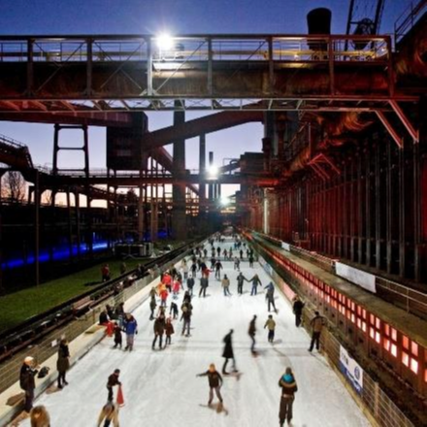
TOURISM | Southeast Minnesota has an opportunity to expand its recent tourism
growth into a regional initiative, leveraging local assets in a coordinated cross-Region
effort.
POST-INDUSTRIAL TOURISM IN THE
RUHR, GERMANY
DESTINATION MARKETING FEE IN
ASHEVILLE, NC
•
The Ruhr leverages
its region’s coal
mining identity to
unify a regional
strategy
•
Asheville levies a
4% destination
marketing fee on
overnight room stays
to generate funds
for destination
marketing and other
tourism initiatives
•
The region converted
a number of
decaying industrial
buildings into
cultural attractions
•
The fund has generated almost $15 million
in funding that has gone to support 16
community projects
•
The Ruhr has 20%
higher tourism
growth than national
trends
HR&A Advisors, Inc.
SE Minnesota Regional Economic Study | 39

Slide 37
IMPLICATIONS | Local autonomy is a critical characteristic of counties and
municipalities throughout the Region, but the Region’s long-term economic success will rely
on close coordination across jurisdictions to address pan-regional challenges.
FEDERAL
STATE
COUNTIES &
MUNICIPALITIES
REGIONAL GROUPS &
NON-PROFITS
HR&A Advisors, Inc.
SE Minnesota Regional Economic Study | 41

Slide 38
IMPLICATIONS | At the federal-level, the Region can advocate for changes to
national legislation and funding that can support funding for transit and affordable
housing initiatives.
FEDERAL
• Transportation funding
• Affordable housing funding
• Immigration policy
• Farming preservation
HR&A Advisors, Inc.
SE Minnesota Regional Economic Study | 42

Slide 39
IMPLICATIONS | At the state-level, there is significant opportunity for coordination
across existing tourism initiatives, in addition to funding and other resource support that
will benefit the Region.
STATE
• Tourism initiatives
• Daycare licensing
• Immigrant resources
• Transportation funding
• Revolving loan fund
HR&A Advisors, Inc.
SE Minnesota Regional Economic Study | 43

Slide 40
IMPLICATIONS | Municipalities will play a critical role in addressing the Region’s
housing needs, but decisions about specific tools used will be made at the local-level.
COUNTY & MUNICIPALITIES
• Land use policies for housing and transit-oriented-
development
• Downtown placemaking for talent attraction
• Immigrant resources
• School-district planning
HR&A Advisors, Inc.
SE Minnesota Regional Economic Study | 44

Slide 41
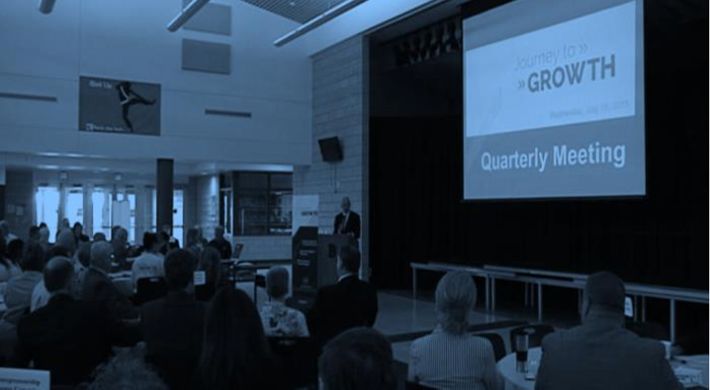
IMPLICATIONS | Regional groups and non-profits have an opportunity to harness the
strength of community involvement and unify that strength throughout the Region.
REGIONAL GROUPS & NON-PROFITS
•
Advocacy and planning for transit and housing
• Region-wide tourism strategy
• Streamlining of childcare regulations
• Immigrant services and support
HR&A Advisors, Inc.
SE Minnesota Regional Economic Study | 45

Slide 42
CLIENT
LOGO HERE
SOUTHEAST MINNESOTA REGIONAL ECONOMIC STUDY
FINDINGS & POLICY RECOMMENDATIONS
2018

